Slide 1

Alteryx User Group NL ​
Q3 Thursday 14th September 2023 16:00-17:30

Slide 2
AGENDA
01
Welcome
02
Ice-breaker
03
Alteryx product update on Auto Insights by Daniel Salway
04
Graph database technology in Alteryx - unlock new possibilities with connected data by Amit Kumar Upadhyay
05
Q&A

Slide 3
HOUSEKEEPING
This meeting will be recorded and shared to the Community.
Interact with us! Type in the chat box, share an emotion, unmute yourself and/or turn your camera on!

Slide 4

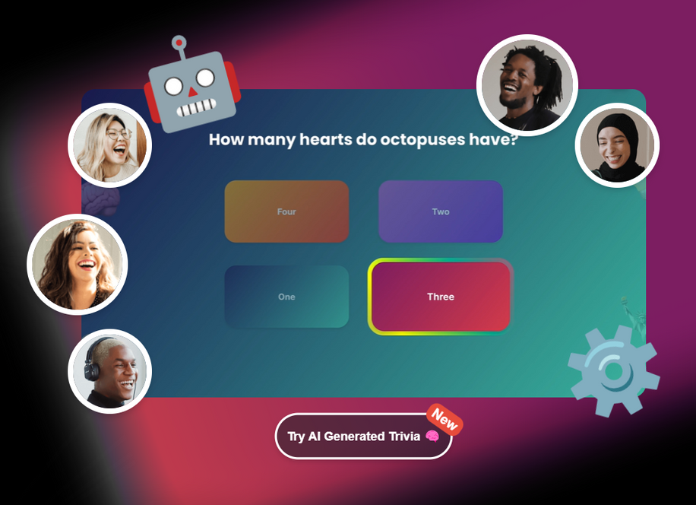
Let’s quiz
Click link in chat

Slide 5
Alteryx product update on Auto Insights
Daniel Salway
Alteryx

Slide 6
Graph database technology in Alteryx
Amit Kumar Upadhyay
LARKinfolab

Slide 7

(Optional) Testing
You
Break-out sessions

Slide 8
Q&A

Slide 9
The end
Let's stay connected! Follow us on LinkedIn for community & Alteryx updates:
Decision Crew
LARKinfolab
The Information Labs NL
YX Stable

Slide 10

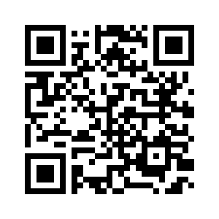

User Group Meeting Survey
14
© 2023 ALTERYX, INC. All rights reserved.
© 2023 ALTERYX, INC. All rights reserved.
Notes:
Survey link: https://survey3.medallia.com/?virtual-user-group
14

